Slide 1
Programming in C

Slide 2
General Aspect of ‘C’
C was originally developed in the 1970s, by Dennis Ritchie at Bell Telephone Laboratories, Inc.
C is a High level , general –purpose structured programming language. Instructions of C consists of terms that are very closely same to algebraic expressions, consisting of certain English keywords such as if, else, for ,do and while
C contains certain additional features that allows it to be used at a lower level , acting as bridge between machine language and the high level languages.
This allows C to be used for system programming as well as for applications programming

Slide 3
The Character set of ‘C’
C language consist of some characters set, numbers and
some special symbols. The character set of C consist of all the alphabets of English language. C consist of
Alphabets a to z, A to Z
Numeric 0,1 to 9
Special Symbols {,},[,],?,+,-,*,/,%,!,;, and more
The words formed from the character set are building
blocks of C and are sometimes known as tokens. These
tokens represent the individual entity of language.
The following different types of token are used in C
1) Identifiers 2)Keywords 3)Constants
4) Operators 5)Punctuation Symbols

Slide 4
Identifiers
A 'C' program consist of two types of elements , user defined and system defined. Idetifiers is nothing but a name given to these eleme
nts.
An identifier is a word used by a programmer to name a variable , function, or label.
identifiers consist of letters and digits, in any order, except that the first charecter or lable.
Identifiers consist of letters and digits if any order,except that the first charecter must be letter.
Both Upper and lowercase letters can be used

Slide 5
Keywords
Keywords are nothing but system defined identifiers.
Keywords are reserved words of the language.
They have specific meaning in the language and cannot be used by the programmer as variable or constant names
C is case senitive, it means these must be used as it is
32 Keywords in C Programming
auto | double | int | struct
break | else | long | switch
case | enum | register | typedef
char | extern | return | union
const | float | short | unsigned
continue | for | signed | void
default | goto | sizeof | volatile
do | if | static | while

Slide 6
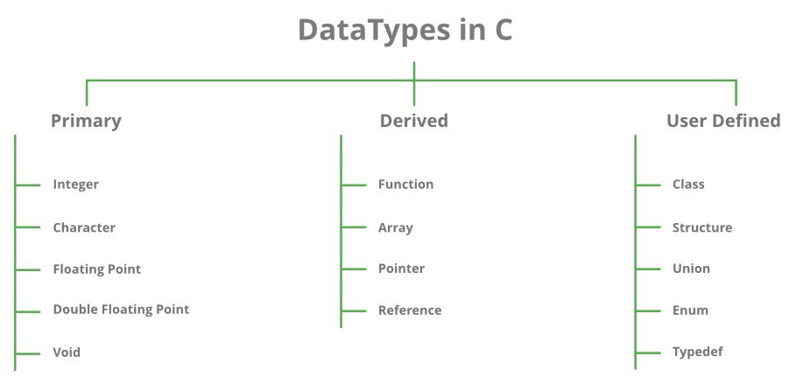
Data Types

Slide 7
Variables
A variable is nothing but a name given to a storage area that our programs can manipulate. Each variable in C has a specific type, which determines the size and layout of the variable's memory; the range of values that can be stored within that memory; and the set of operations that can be applied to the variable.
The name of a variable can be composed of letters, digits, and the underscore character. It must begin with either a letter or an underscore. Upper and lowercase letters are distinct because C is case-sensitive. There are following basic variable types −
Type Description
char Typically a single octet(one byte). This is an integer type.
int The most natural size of integer for the machine.
float A single-precision floating point value.
double A double-precision floating point value.
void Represents the absence of type.

Slide 8
Constants
A constant is a value or an identifier whose value cannot be altered in a program. For example: 1, 2.5,
As mentioned, an identifier also can be defined as a constant. eg. const double PI = 3.14
Here, PI is a constant. Basically what it means is that, PI and 3.14 is same for this program.
Integer constants
A integer constant is a numeric constant (associated with number) without any fractional or exponential part. There are three types of integer constants in C programming:
decimal constant(base 10)
octal constant(base 8)
hexadecimal constant(base 16)

Slide 9
Constants
Floating-point constants
A floating point constant is a numeric constant that has either a fractional form or an exponent form. For example: 2.0,0.0000234,-0.22E-5
Character constants
A character constant is a constant which uses single quotation around characters. For example: 'a', 'l', 'm', 'F'
String constants
String constants are the constants which are enclosed in a pair of double-quote marks. For example: "good" ,"x","Earth is round\n"

Slide 10
Escape Sequences
Sometimes, it is necessary to use characters which cannot be typed or has special meaning in C programming. For example: newline(enter), tab, question mark etc. In order to use these characters, escape sequence is used.
For example: \n is used for newline. The backslash ( \ ) causes "escape" from the normal way the characters are interpreted by the compiler.Escape
Sequences Character
\b Backspace
\f Form feed
\n Newline
\r Return
\t Horizontal tab
\v Vertical tab
\\ Backslash
\' Single quotation mark
\" Double quotation mark
\? Question mark
\0 Null character

Slide 11
Operators in C:.
Arithmetic Operators
Increment and Decrement Operators
Assignment Operators
Relational Operators
Logical Operators
Conditional Operators
Bitwise Operators
Special Operators

Slide 12
Arithmetic Operator
Operator Meaning of Operator
+ addition or unary plus
- subtraction or unary minus
* multiplication
/ division
% remainder after division( modulo division)

Slide 13
Increment and Decrement Operators
1. C programming has two operators increment ++ and decrement -- to change the value of an operand (constant or variable) by 1.
2. Increment ++ increases the value by 1 whereas decrement -- decreases the value by 1.
3. These two operators are unary operators, meaning they only operate on a single operand.
eg. int a=10, b=100
++a = 11
--b = 99

Slide 14
C Assignment Operators
An assignment operator is used for assigning a value to a variable. The most common assignment operator is =
Operator Example Same as
= a = b a = b
+= a += b a = a+b
-= a -= b a = a-b
*= a *= b a = a*b
/= a /= b a = a/b
%= a %= b a = a%b

Slide 15
C Relational Operators
A relational operator checks the relationship between two operands. If the relation is true, it returns 1; if the relation is false, it returns value 0.
Relational operators are used in decision making and loops.
Operator Meaning of Operator Example
== Equal to 5 == 3 returns 0
> Greater than 5 > 3 returns 1
< Less than 5 < 3 returns 0
!= Not equal to 5 != 3 returns 1
>= Greater than or equal to 5 >= 3 returns 1
<= Less than or equal to 5 <= 3 return 0

Slide 16
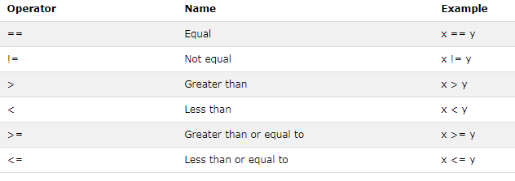
Comparison Operators

Slide 17
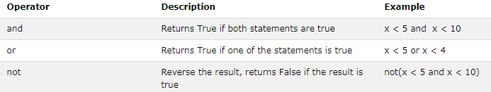
Logical Operators
  Example
  if ( marks >= 40 && attendance >= 75 ) grade = ‘P’
  If ( marks < 40 || attendance < 75 ) grade = ‘N’

Slide 18
A First Program
makes input
and output available
to us
#include <stdio.h>
int main(void)
{
printf("This is my first C program.\n");
return(0);
}
header
open and close braces mark
the beginning and end
statements

Slide 19
A First Program – What Does It Do?
  printf("This is my first C program.\n");
  return(0);
Prints the message
This is my first C program.
Ends the program
Ends the line

Slide 20
Java Reminder
Program | C | Java
hello, world | #include<stdio.h> | public class HelloWorld {
 | int main(void) { | public static void main(String[] args) {
 | printf("Hello\n"); | System.out.println("Hello");
 | return 0; | }
 | } | }

Slide 21
C Program Phases
Editor - code by programmer
Compiling using gcc:
  Preprocess – expand the programmer’s code
  Compiler – create machine code for each file
  Linker – links with libraries and all compiled objects to make executable
Running the executable:
  Loader – puts the program in memory to run it
  CPU – runs the program instructions

Slide 22
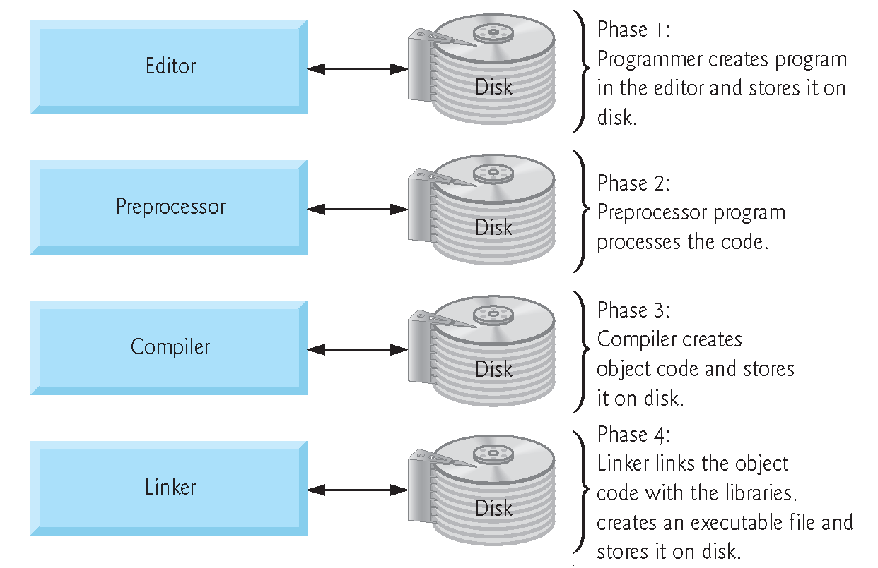

Slide 23
Using variables
#include <stdio.h>
int main(void)
{
int sum, value1, value2, value3;
float average;
value1 = 2;
value2 = 4;
value3 = 6;
sum = 2 + 4 + 6;
average = sum / 3;
printf("The average of %d , %d, %d is %f\n", value1, value2, value3, average);
return(0);
}
Print a float value from the
rest of the parameter list

Slide 24
# Task 1-User Input
Let’s rewrite the average program so it can find the average any 3 numbers we try:
We now need to:
  Find our three values
  Add the values
  Divide the sum by 3
  Print the result

Slide 25
Average3.c
#include <stdio.h>
int main(void)
{
int value1, value2, value3;
float sum, average;
printf("What is the first value? ");
scanf("%d", &value1);
printf("What is the second value? ");
scanf("%d", &value2);
Read
The address of variable value1
Indicates that we are
reading an integer

Slide 26
printf("What is the third value? ");
scanf("%d", &value3);
sum = value1 + value2 + value3;
average = sum / 3;
printf("The average of %d , %d, %d is %f\n", value1, value2, value3, average); return(0);
}
scanf needs the &
before the identifier

Slide 27
Average – add comments
#include <stdio.h>
/*
* This program calculates average pay
*/
int main(void)
{
int value1, value2, value3;
float sum, average;
string
// now get the first value
;
comments

Slide 28
Input and Output Functions
Include
Variable types: int, float, char
Read using scanf
  requires & for address of variable being read
Print using printf
Format strings: %f (float), %d (int), %u (unsigned int), %c (char), %s (character array)
Comments /*.. */ or //

Slide 29
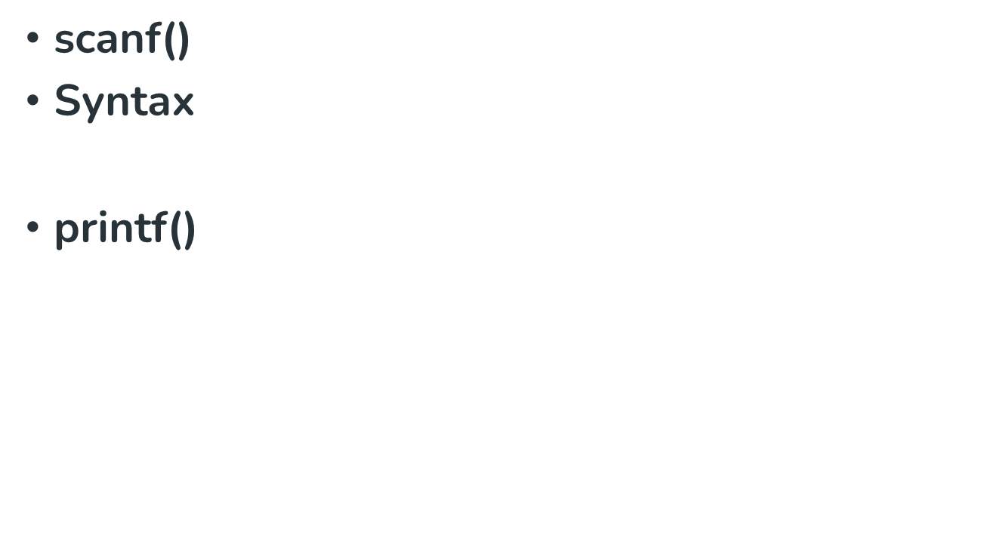

scanf("%X", &variableOfXType);

Slide 30
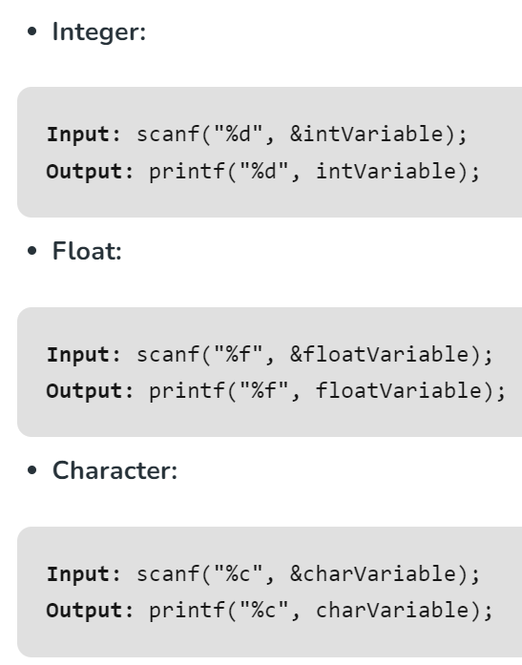

Slide 31
// C program to show input and output
#include <stdio.h>
int main()
{
// Declare the variables
int num;
char ch;
float f;
// --- Integer ---
// Input the integer
printf("Enter the integer: ");
scanf("%d", &num);

Slide 32
// Output the integer
printf("\n Entered integer is: %d", num);
// --- Float ---
//For input Clearing buffer
while((getchar()) != '\n’);
// Input the float
printf("\n\nEnter the float: ");
scanf("%f", &f);

Slide 33
// Output the float
printf("\nEntered float is: %f", f);
// --- Character ---
// Input the Character
printf("\n\nEnter the Character: ");
scanf("%c", &ch);
// Output the Character
printf("\nEntered character is: %c", ch);
return 0;
}

Slide 34
IsItNeg.c – illustrate if
#include <stdio.h>
// Tell a user if a number is negative
int main(void)
{ float number;
/* Ask the user for a number */
printf("Please enter a number ? ");
scanf("%f", &number);
// Print whether the number is negative or not
if (number < 0){
printf("%f is a negative number\n", number); }
else {
printf("%f is NOT a negative number\n", number); }
return(0); }

Slide 35

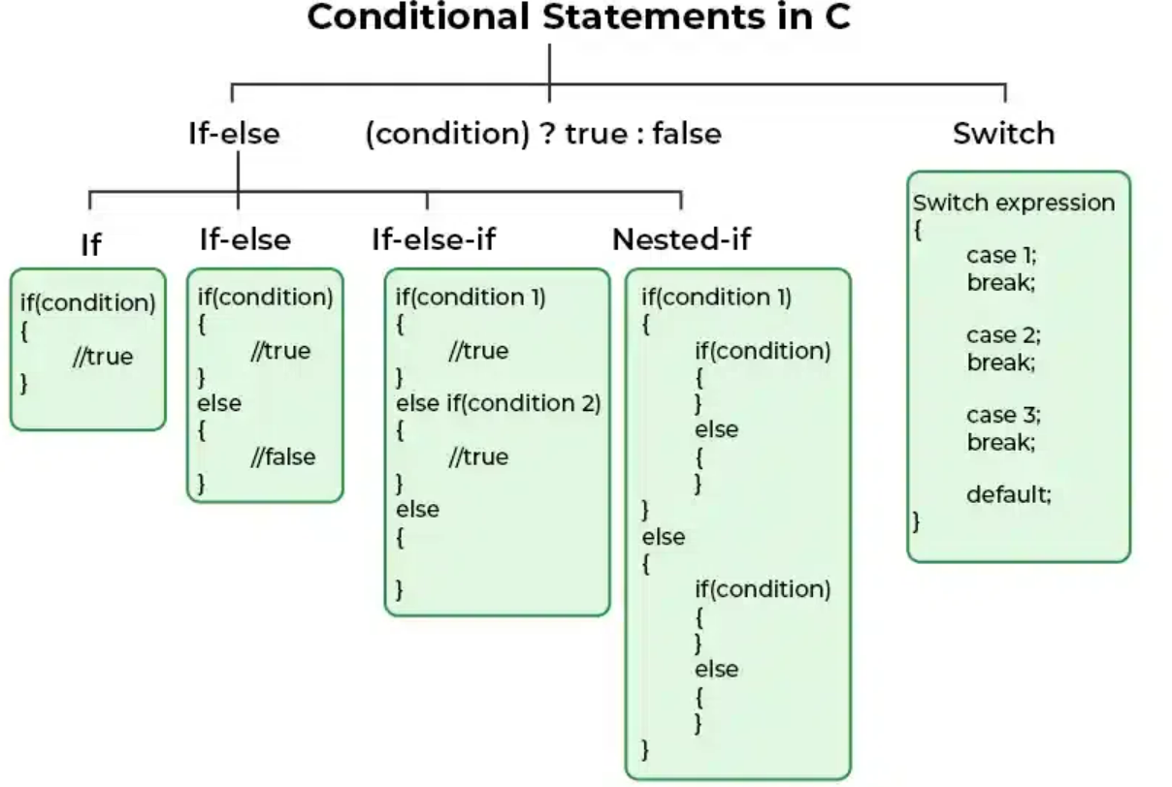

Slide 36

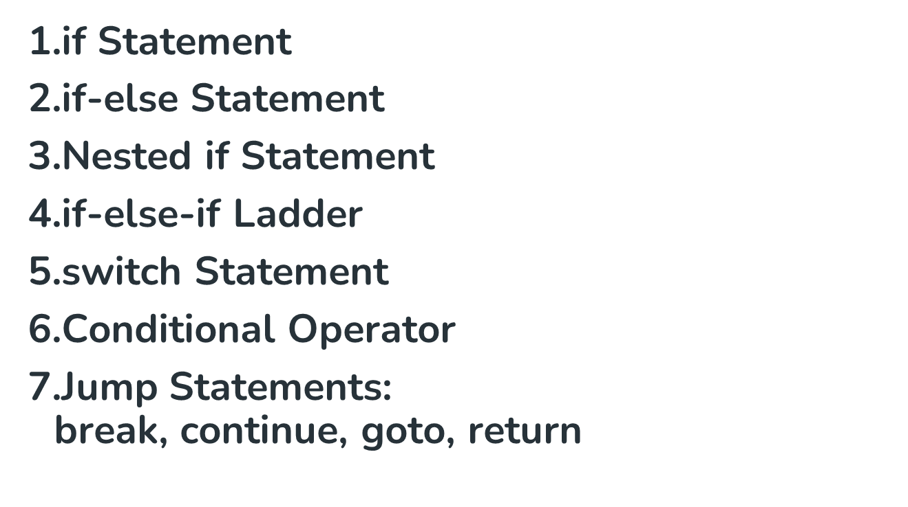

Slide 37
Example:
#include <stdio.h>
int main()
{
// if block with condition at the start
if (5 < 10) {
// will be executed if the condition is true
printf("5 is less than 10.");
}
// else block after the if block
else {
// will be executed if the condition is false
printf("5 is greater that 10.");
}
return 0;
}

Slide 38
#include <stdio.h>
int main()
{
// switch variable
int var = 1;
// switch statement
switch (var) {
case 1:
printf("Case 1 is Matched.");
break;
case 2:
printf("Case 2 is Matched.");
break;

Slide 39
case 3:
printf("Case 3 is Matched.");
break;
default:
printf("Default case is Matched.");
break;
}
return 0;
}

Slide 40
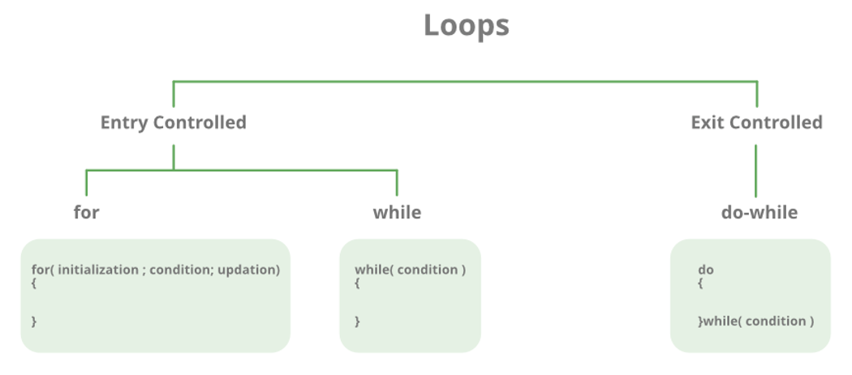
Looping Statements

Slide 41
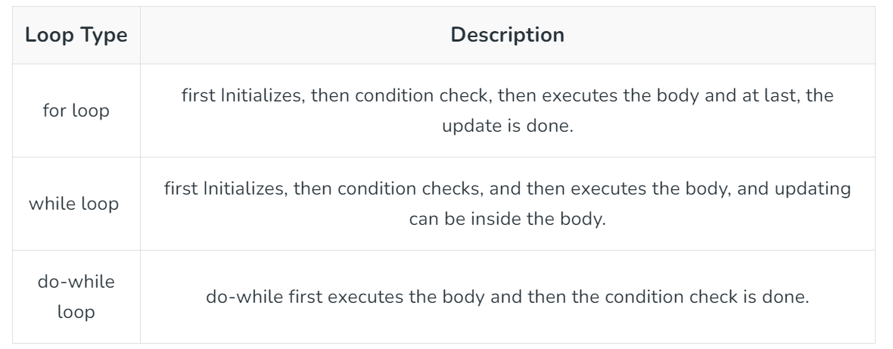

Slide 42
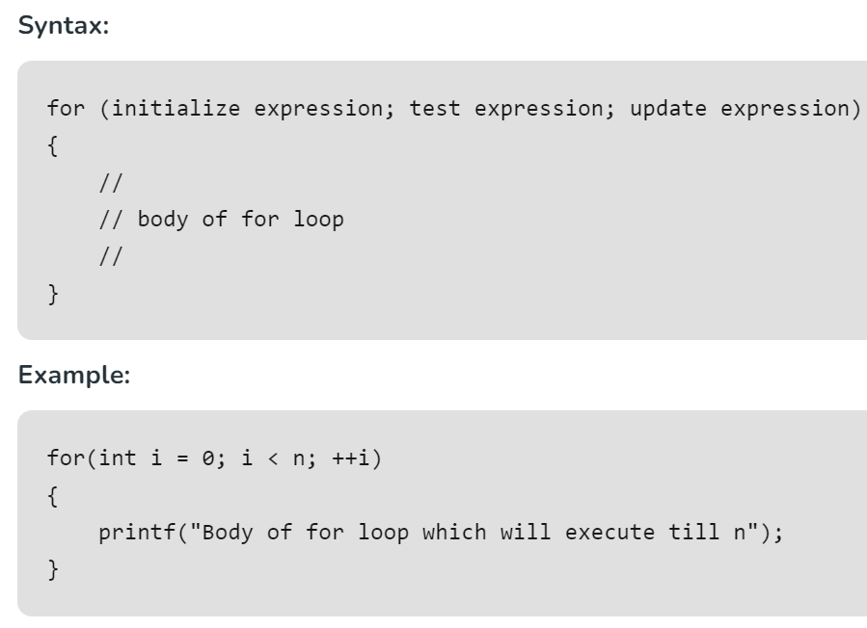
For Loop :
Example:
#include <stdio.h>
int main()
{
int i = 0;
for (i = 1; i <= 10; i++)
{
printf( "Hello World\n");
}
return 0;
}

Slide 43

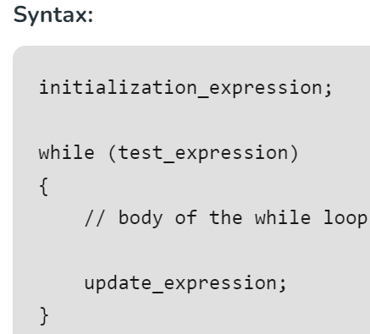
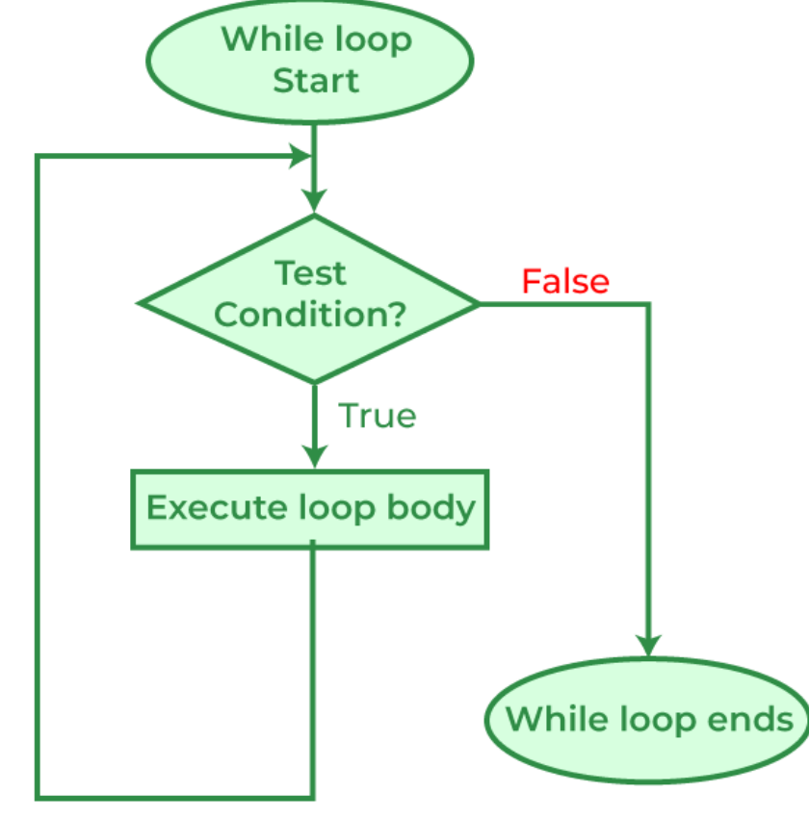

Slide 44
#include <stdio.h>
int main()
{
// Initialization expression
int i = 2;
// Test expression
while(i < 10)
{
// loop body
printf( "Hello World\n");
i++;}
return 0;}

Slide 45
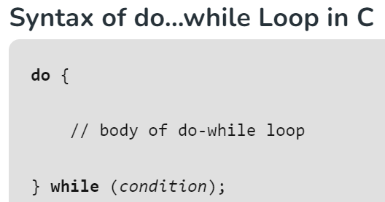
Do-While Loop
#include <stdio.h>
int main()
{
int i = 0;
// do while loop
do {
printf(“Hai\n");
i++;
} while (i < 3);
return 0;}

Slide 46
Program

Slide 47
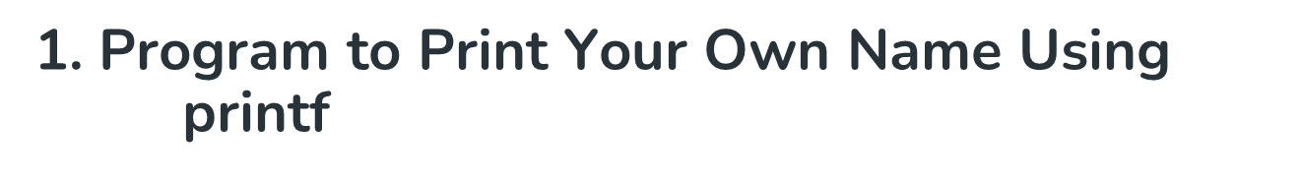
#include <stdio.h>
int main()
{
// Printing your name "Rahul" on the output screen
printf ("Rahul");
return 0;
}

Slide 48

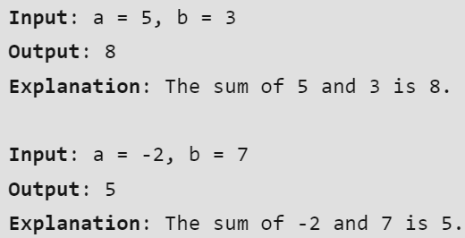

Slide 49
#include <stdio.h>
int main()
{
int A, B, sum = 0;
// Ask user to enter the two numbers
printf("Enter two integers: ");
// Read two numbers from the user || A = 2, B = 3
scanf("%d %d", &A, &B);
// Calculate the addition of A and B
// using '+' operator
sum = A + B;
// Print the sum
printf("Sum: %d", sum);
return 0;
}

Slide 50
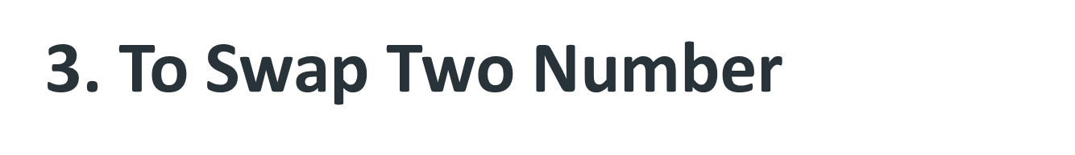
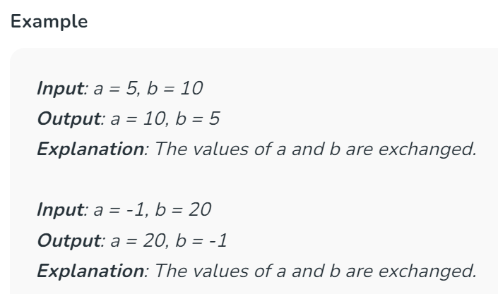

Slide 51
// C Program to Swap Two Numbers using a Temporary Variable
#include <stdio.h>
int main()
{
int a = 5, b = 10, temp;
printf("Before swapping: a = %d, b = %d\n", a, b);
// Store the value of a in temp
temp = a;
// Assign the value of b to a
a = b;
// Assign the value stored in temp to b
b = temp;
printf("After swapping: a = %d, b = %d\n", a, b);
return 0;
}

Slide 52
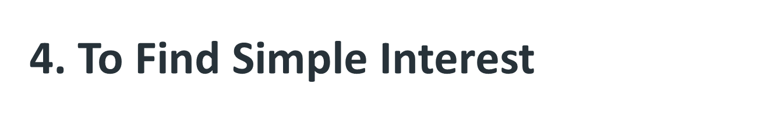
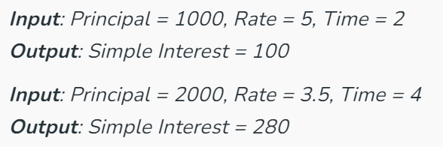

Slide 53
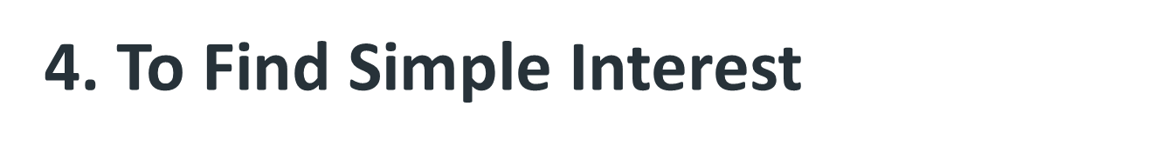
#include <stdio.h>
int main()
{
// Input values
float P = 1, R = 1, T = 1;
// Calculate simple interest
float SI = (P * T * R) / 100;
// Print Simple Interest
printf("Simple Interest = %f\n", SI);
return 0;
}

Slide 54
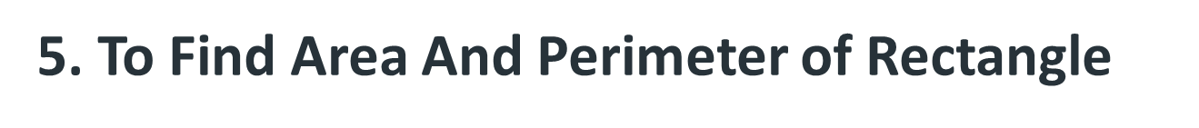
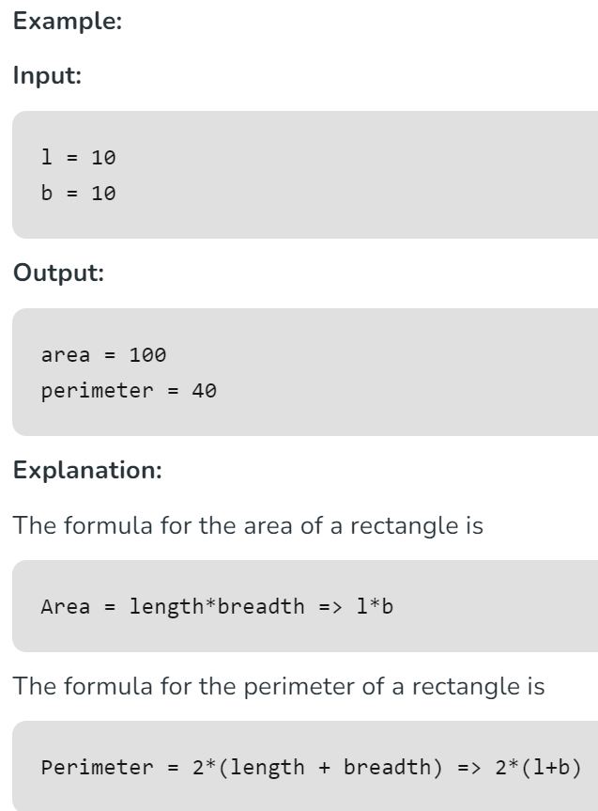

Slide 55
#include <stdio.h>
int main()
{
int l = 10, b = 10;
printf("Area of rectangle is : %d", l * b);
printf("\nPerimeter of rectangle is : %d", 2 * (l + b));
return 0;
}

Slide 56

